Slide 1

Getting to know Alfresco Share

Slide 2
Table of Contents
Share Architecture
Spring Surf Overview
Share sites overview
Admin Console
Smart Folders
Roles and Permissions
Lab

Slide 3
Share Overview
Alfresco Share (share.war) is a web application that runs on the Java Platform.
In a development environment it is usually deployed and run on top of Apache Tomcat. Share is built up of a main menu that leads to pages, which is similar to most other web applications that you might come across.
However, there is one special page type called Dashboard that contains dashlets.
A Dashboard page can be configured by the end-user, who can add, remove, and organize the dashlets on the page.
Share pages and dashlets are implemented with something called web scripts, which is basically REST-based APIs.
These APIs are called Surf web scripts when you are dealing with Alfresco Share.
There is also repository web scripts that are used to extend the repository web application (alfresco.war) with REST-based APIs.
3

Slide 4
Share Overview
Surf Web Scripts are referred to as Presentation Web Scripts and the repository web scripts as Data Web Scripts.
Share web scripts, pages, and dashlets are implemented with a user interface (UI) development framework called Surf.
It provides a way of breaking a HTML page into re-usable component parts.
Surf is built on top of the Spring Web MVC technology, which in turn uses the Spring Framework.
4

Slide 5
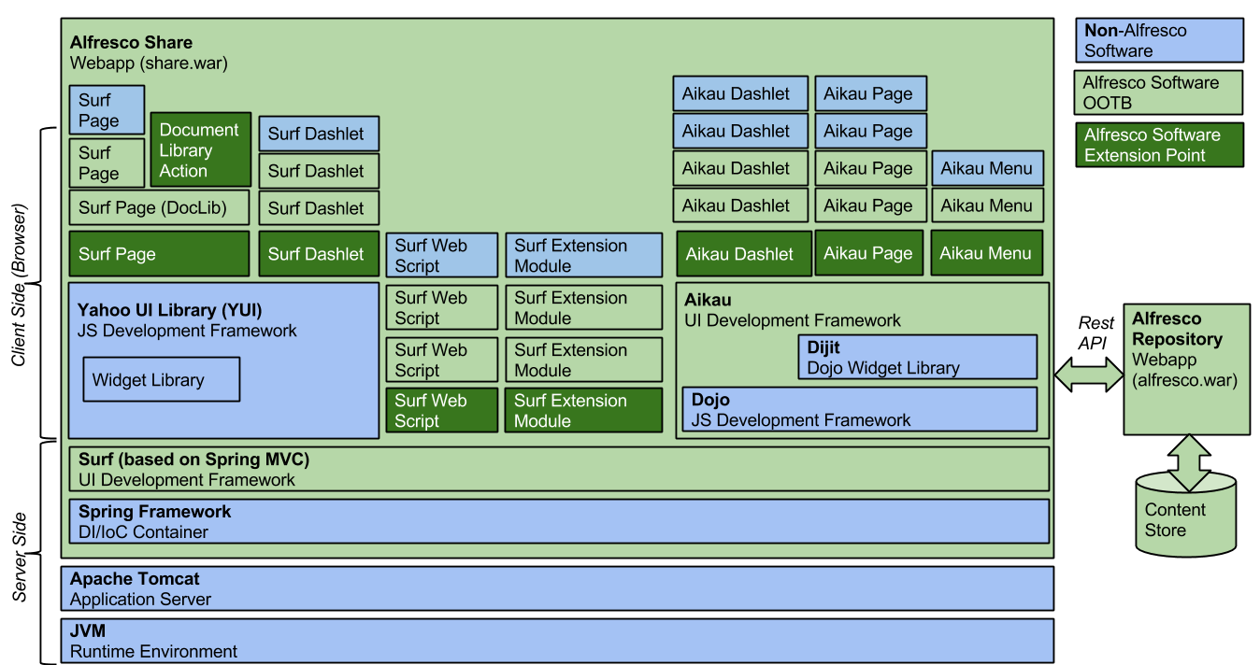
Share Architecture
5

Slide 6
Share Overview
Share gets the content that it should display in pages and dashlets by calling repository web scripts, which returns JSON or XML that can be incorporated into the presentation.
The presentation is actually put together with two different kinds of JavaScript frameworks, Yahoo UI library (YUI) and Aikau, which is based on Dojo.
An Aikau page is based on Surf but it makes page composition much easier than with pure Surf pages.
6

Slide 7
Share Overview
You can focus solely on Aikau if the only thing you are going to do is add new stuff to the Share UI. However, if you need to alter behavior of existing pages, then you might also need to get up to speed on the details of the Surf page model, as only the following has been converted to Aikau:
Share Header Menu and Title (4.2)
Live Search (5.0)
Filtered Search Page (5.0)
Search Management Page (5.0)
Site Management Page (5.0)
Analytics and Reporting Widgets (5.0)
Document List prototype (5.0)
7

Slide 8
Surf Framework Overview
Surf lets you build user interfaces for web applications using server-side scripts and templates without Java coding, recompilation, or server restarts.
Surf follows a content-driven approach, where scripts and templates are simple files on disk so that you can make changes to a live site in a text editor.
Surf's object model lets you define pages, templates, components, and themes using XML. The Spring application picks up new files and processes them through scripts and templates to produce the view, and writes scripts using server-side JavaScript.
Templates are written using FreeMarker.
You can build both page-centric and content-centric websites using Surf, and it provides out-of-the-box support for rendering content delivered through content delivery services, such as CMIS, Atom, and RSS.
8
Notes:
Surf is a Spring framework extension for building new Spring framework applications or plugging into existing Spring web MVC (Model, View, Controller)applications. Spring Web MVC provides separation between the application Model, View, and Controller (known as MVC). You can use Surf with other popular Spring Web MVC technologies including Tiles, Grails, and Web Flow.

Slide 9
Surf Framework Overview
Features
Scripts and templates: Everything in Surf consists of scripts, templates, or configuration. This means no server restarts or compilation.
Reusability: Surf’s presentation objects, templates, and scripts emphasize reusability. Scoped regions and component bindings allow you to describe presentation with less code.
RESTful scripts and templates: All page elements and remote interfaces are delivered through a RESTful API. The full feature set of web scripts is available to Surf applications. Write new remote interfaces or new portlets with a script, a template, and a configuration file.
9

Slide 10
Surf Framework Overview
Content management: A set of client libraries and out-of-the-box components streamline interoperability with CMIS content management systems, letting you easily access and present Enterprise content using Surf components and templates.
Two-tier architecture: Surf works in a decoupled architecture where the presentation tier is separate from the content services tier.
10

Slide 11
Surf Framework Overview
Surf View Composition framework
Surf provides a View Composition framework that lets you define user interface items such as:
Pages
Templates
Regions
Components
11

Slide 12
Surf Framework Overview
Templates and regions
A template is a reusable layout that you can build once and then apply it to many pages.
Each page can then benefit from a common look-and-feel that was pre-prescribed.
By changing the template, a web designer can affect many pages all at the same time.
This is especially meaningful for large websites where you might need to manage hundreds, if not thousands, of pages.
When Surf looks at a URI and determines the request, it starts the process of handling the view.
The request might be for a specific page, a content item of type “article”, or a specific region of the current page (for example, in an AJAX request).
Regardless of the request, the objective will eventually produce markup and send it out to the response.
The key to making this happen is the template, which provides the basic layout of the response to the browser.
12

Slide 13
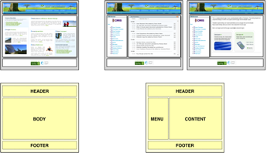
Surf Framework Overview
The following figure shows three pages for a sample website. Two of the pages are similar with the same page layout. They have four regions on the page, whereas the first page has only three regions. As such, you can describe these three pages with two templates. The templates are shown underneath the pages.
The first template defines three regions with placeholder names (HEADER, BODY, FOOTER). The second template defines four regions (HEADER, MENU, CONTENT, FOOTER). The HEADER and FOOTER regions are common across all three pages. You can define the two templates in Surf and define regions along with region scope to allow reuse across templates
13

Slide 14
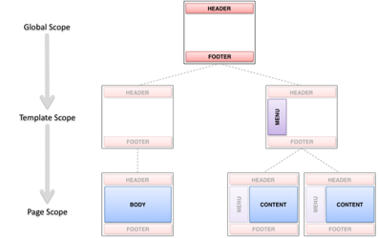
Surf Framework Overview
In this figure, the region scope defines the entire website with only two templates and five scoped regions. There are three scopes: global, template, and page. Regions in the global scope need to be configured only once. Then, their configuration is reused by any templates or pages that include them. In this case, the HEADER and FOOTER regions are defined once in the global scope. Their content appears the same on all of the pages of the site.
14

Slide 15
Surf Framework Overview
Regions in the template scope need to be configured once per template.
Any pages that use the template then reuse their configuration.
In this case, the MENU region is defined in the template scope for one of the templates, but not the other.
Thus, the two pages on the right side that use this template will have the MENU region in common.
Regions in the page scope must be configured once per page, and their configurations are not reused.
In this case, the BODY and CONTENT regions are in the page scope.
This allows the two right-hand pages to be slightly different, but only in the CONTENT region.
15

Slide 16
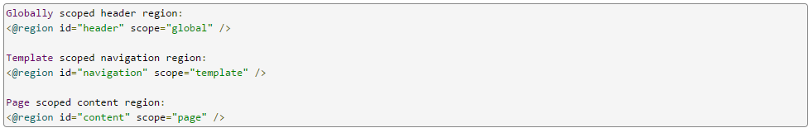
Surf Framework Overview
The region tag defines regions on a template with the scope, such as page, template, or global. The following examples show how this is done in FreeMarker:
16

Slide 17
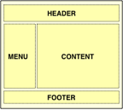
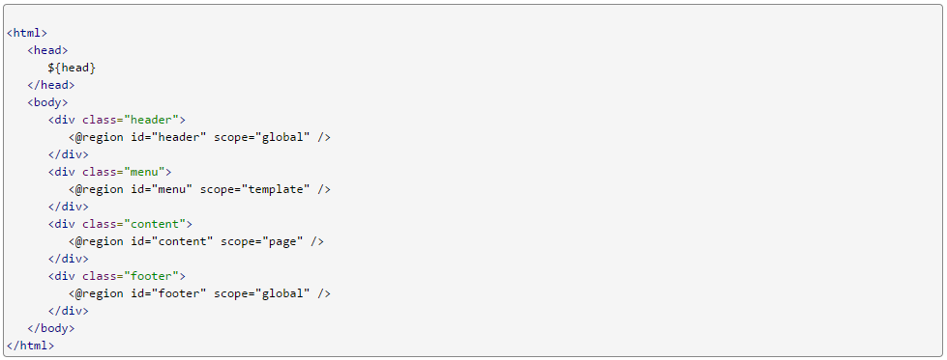
Surf Framework Overview
A template defines the basic structure of the rendered view, and then defines regions into which to include additional presentation. The following figure shows an example of the template that defines four regions: HEADER, MENU, CONTENT, and FOOTER.
When the template is processed, each of its region tags executes and attempts to look up something that should be included in that location in the template. The region tag is replaced by the output of something that is bound into that place in the template.
17

Slide 18
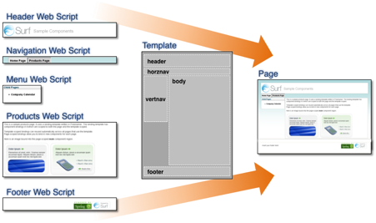
Surf Framework Overview
Components
Surf lets you bind components to regions. A component usually associates a region with a web script.
Templates and scoped regions make it possible to reuse web scripts. You can have as many web scripts as you like, each encapsulating a unique bit of application functionality.
18

Slide 19
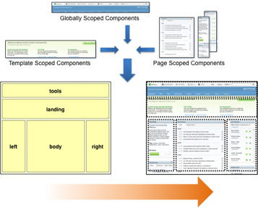
Surf Framework Overview
A template brings several web scripts together into an overall markup structure. Here, you are rendering a page; however, the same concepts apply for any kind of view rendered from Surf using a template. Surf lets you define regions in various scopes and then resolves these upon request. This makes your site definition efficient and easier to manage by promoting reuse. Alfresco Share is an example of a Surf application whose pages are constructed through reuse of templates. All three scopes are used. The following figure provides an example of how this fits together.
19

Slide 20
Surf Framework Overview
You can make changes to Alfresco Share pages by tweaking FreeMarker templates and web scripts.
In Surf, web scripts not only provision remote interfaces to your applications, but also provide your application's presentation logic.
These are presentation tier web scripts. Surf orchestrates them so they can all live together on a single view and interoperate against a common request context.
There are many more capabilities, such as pre-processing controllers to generate markup that should be injected into different parts of a page (for example, the <head> of an HTML page).
Surf also provides additional web script and template API root-scoped objects and methods.
20

Slide 21
Web scripts and Surf
Surf lets you reuse web scripts and bind them together into unlimited numbers of pages.
The scripts are lightweight, making them easy to assemble and deploy.
Surf provides each web script with the appropriate context and runtime environment to render in the context of the overall request.
The output of each web script merges with the output of the template to form the final markup.
This markup is returned from the Spring MVC view.
21

Slide 22
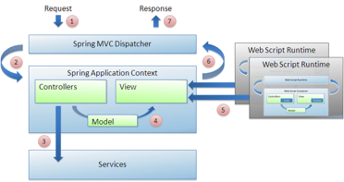
Web scripts and Surf
The dispatcher handles an incoming request. Imagine that the incoming URI is /hotels.
The dispatcher tries to find a matching controller for this URI.
A controller is invoked if found. The controller calls out to some services to retrieve a list of hotels, creates a model, and then places this list of hotels into the model.
The dispatcher tries to find a matching view for this URI.
A view is invoked if found. The view receives the model and uses it to render HTML markup that displays the list of hotels.
The response is sent back to the end user.
22

Slide 23
Web scripts and Surf
Surf content types
In Spring Surf, content is divided into Semantic content and Presentation content, and the web application looks at both to render the final look of the Web page.
Semantic content
Presentation content
23

Slide 24
Web scripts and Surf
Semantic content
Semantic content represents the domain specific content that should be displayed on the web page.
This can be for example project information, document information, customer information, discussion thread, wiki page data, workflow task information.
This content is typically authored, approved, and published.
Semantic content describes what should be rendered.
It contains the approved message but it does not contain any formatting information.
It is represented in a structured data format, such as JSON or XML.
24

Slide 25
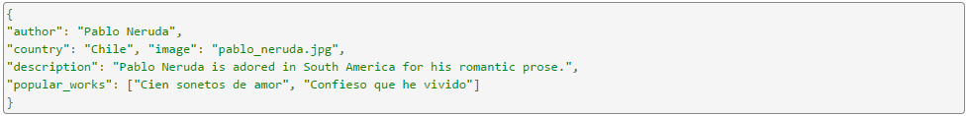
Web scripts and Surf
The following code is an example of JSON text for a biography:
This code does not contain any formatting like HTML tags or other markup, just simple data. This type of content is usually fetched by a Spring Surf Web Script dynamically
25

Slide 26
Web scripts and Surf
Presentation content
Presentation content are files that describe presentation configuration for a website, it is represented in XML and FreeMarker template files. Presentation content comprises configuration that tells the Surf rendering engine how the Web page or page component should look and feel.
Presentation content answers questions like:
What is the layout of the Web page
Which theme to use to render the Web page
How many articles to display on a Web page
Which advertisement to display in a particular section of the site for the current user
26

Slide 27
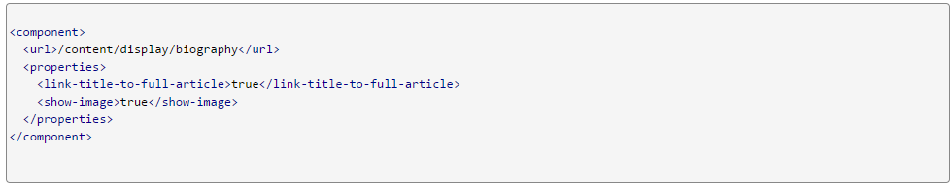
Web scripts and Surf
A website presentation framework, such as Surf, looks to this content to figure out how to display the page. For example, the following XML code configures a Surf Web Script for rendering a biography to end users and tells the web script to render a link to the full article as well as to show the image of the author.
These properties are custom properties that are just passed on to the Web Script implementation. This component definition tells Surf to call this Web Script (i.e. /content/display/biography) to render the biography.
27

Slide 28
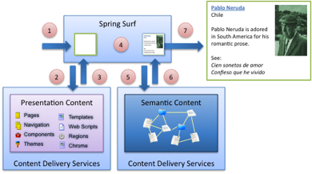
Web scripts and Surf
Surf receives the browser request.
Surf asks the content delivery services for the Presentation Content that describes what is being requested.
The Presentation Content is handed back as XML and FTL.
Surf determines the Web Script to execute using the configuration specified by the component XML.
The Web Script Controller (JavaScript or Java) calls a service somewhere to retrieve biography data.
28

Slide 29
Web scripts and Surf
The biography is returned as JSON.
The Web Script Template (FreeMarker) renders HTML markup to the end user. This HTML contains presentation output (formatting) as well as the semantic data (the biography itself).
The website user then sees the poet's content. Rending a complete Web page with more stuff then just the biography, such as title, footer, header etc, will loop through step 4 - 7 multiple times.
29

Slide 30

Using Alfresco Share
Demo
30

Slide 31
Using Alfresco Share
Sites
A site is a area where you can share content and collaborate with other site members.
Any user can create a site.
The site creator becomes the Site Manager by default, though additional or alternate managers can be added after this.
Each site has a visibility setting that marks the site as public, moderated, or private. This setting controls who can see the site and how users become site members.
31

Slide 32
Using Alfresco Share
Types of Sites
Public site - All users can view the content but only site members can work with the content. Any user can join the site.
Moderated site - All users can access the site but only site members can see and work with the content. Users must ask to join the site.
Private site - Only site members can access the site. Users must be added to the site by a site manager.
The manager of any site—whether public or private—can add users. You can remove yourself from a site at any time by clicking in the site and selecting Leave Site.
32

Slide 33
,
Alfresco Share Overview
Smart Folders
A Smart Folder is a way of grouping files from different locations in Alfresco Share into a single folder, so that you can quickly find similar files.
A search runs when you open the contents of the Smart Folder, and the results are displayed. It is "smart", because there is no physical folder to represent it in the repository.
For example, a Smart Folder called My video files might be created to contain all files that I created that have a video format.
Every time I open the My video files folder, the search runs, and all my video files are available in that folder, wherever in the repository I have created them.
Files are also automatically classified when they're uploaded into these folders.
33

Slide 34
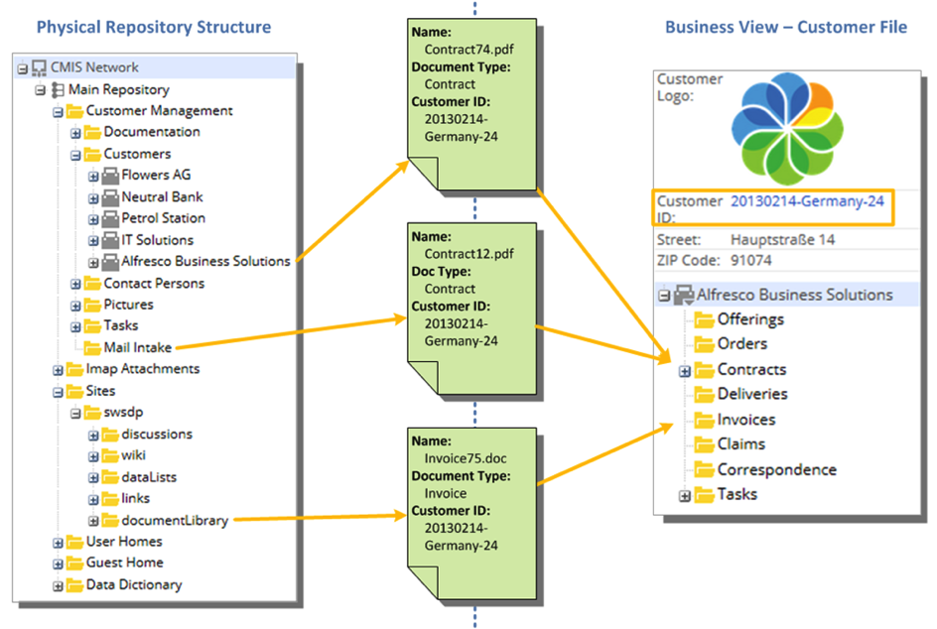
,
Alfresco Share Overview
The diagram shows a physical file system, and how a Smart Folder structure is created to contain files relevant to a particular customer:
34

Slide 35
,
Alfresco Share Overview
Smart Folders have a limited set of actions:
Add/ Create: You can add files to a Smart Folder. The file is put into a physical folder, as specified by the filing rule.
Update: You can update files in a Smart Folder. Updating a property might result in a file being removed from the current Smart Folder (because it no longer meets the query criteria).
Delete, Edit Properties, Unzip To, Sync, Locate To, Move, and Copy actions for files are not supported.
The Smart Folder itself can't be edited in Alfresco Content Services, except through the Smart Folder Template.
35

Slide 36
,
Alfresco Share Overview
User roles and permissions
A user's role determines what they can and cannot do in a site. Each role has a default set of permissions.
The following sections describe these permissions. In general:
Managers - have full rights to all site content; what they have created themselves and what other site members have created.
Collaborators - have full rights to the site content that they own; they have rights to edit but not delete content created by other site members.
Contributors - have full rights to the site content that they own; they cannot edit or delete content created by other site members.
Consumers - have view-only rights in a site: they cannot create their own content.
36

Slide 37
Lab
Customizing your dashboard
Setting your homepage
Updating your profile
Following people
Controlling your email notifications
Disabling your site notifications
Accessing existing sites
Site dashboard
Managing a site
Managing site members
Adding content
Viewing content
37

Slide 38
Lab
Working with files and folders
Applying rules to folders
Organizing content
Using social features
Working with files outside the library
Starting a workflow
Viewing workflows you started
Cancelling an active workflow
Viewing tasks and workflows
The calendar
The wiki
The discussion forum
38

Slide 39
Lab
The blog
Site links
Data lists
Use the Site Finder
Use the People Finder
Use the Advanced Search
39

Slide 40
Thank you

